Slide 1


Green Pace
Security Policy Presentation
Developer: Devon C. Darling

Slide 2

OVERVIEW: DEFENSE IN DEPTH

Slide 3
THREATS MATRIX
Likely 1,2,3,5,6,9,10 | Priority 2,3,4,5,8,9
Low priority 1,6,7,10 | Unlikely 4,7,8

Slide 4
10 PRINCIPLES
Validate Input Data
Heed Compiler Warnings
Architect and Design for Security Policies
Keep It Simple
Default Deny
Adhere to the Principle of Least Privilege
Sanitize Data Sent to Other Systems
Practice Defense in Depth
Use Effective Quality Assurance Techniques
Adopt a Secure Coding Standard
1. Data Type
2. Data Value
3. String Correctness
4. SQL Injection
5. Memory Protection
6. Assertions
7. Exceptions
8. Data Sanitization
9. Dangling Pointer
10. Proper Naming

Slide 5
CODING STANDARDS
Data Sanitization
SQL Injection
Dangling Pointer
Memory Protection
Data Value
String Correctness
Assertions
Exceptions
Data Type
Proper Naming

Slide 6
ENCRYPTION POLICIES
Encryption in Rest
Encryption at Flight
Encryption in Use

Slide 7
TRIPLE-A POLICIES
Authentication
Authorization
Accounting

Slide 8

Test to verify the std::out_of_range exception is thrown when calling at() with an index out of bounds (Negative)

Slide 9
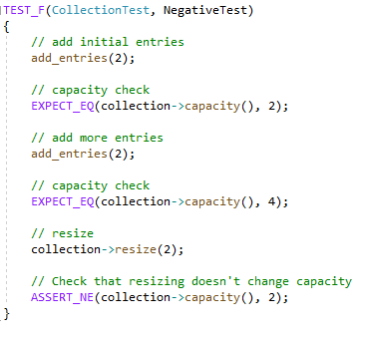
Negative test to prove adding entries and resizing changes capacity (Negative)

Slide 10
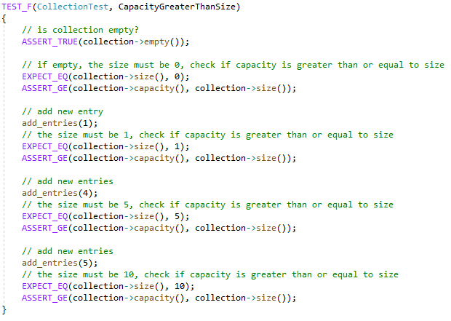
Test to verify that capacity is greater than or equal to size for 0, 1, 5, 10 entries (Positive)

Slide 11
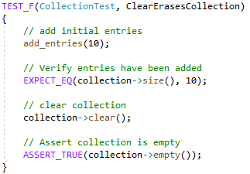
Test to verify clear erases the collection (Positive)

Slide 12

AUTOMATION SUMMARY

Slide 13
TOOLS
Static Analysis Tools
Vulnerability Scans
Parasoft C/C++ test

Slide 14
RISKS AND BENEFITS
Act Now or Act Later?

Slide 15
RECOMMENDATIONS
Default Deny
Keep it Simple
Adhere to the Principle of Least Privilege
Heed Compiler Warning

Slide 16
CONCLUSIONS
Permissions
Subsystems

Slide 17
REFERENCES
[Provide APA-style references with links to resources, articles, and videos that you used in your presentation.]

